Slide 1
Hospital management system
Relaxed style presentation
29.04.24
Ding Yeming

Slide 2

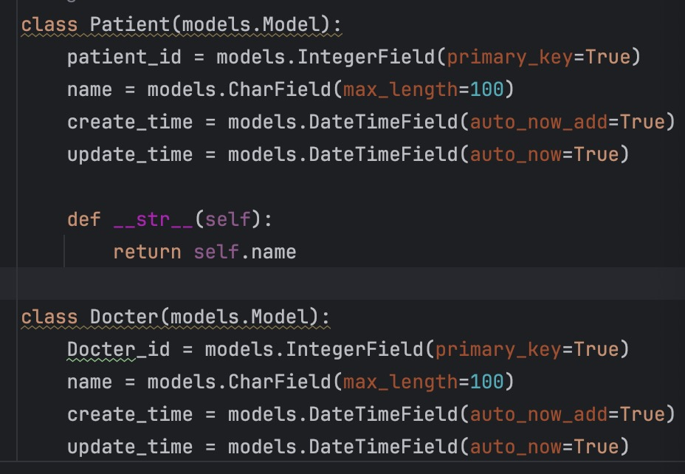

Slide 3
Patient: Includes the basic information of the patient, the patient's pathology report of the day, the patient's past medical history； Doctors: Control patient registration numbers, writing of patient report forms, prescribing and pharmacy links； Hospital department：Outpatient department, inpatient department, emergency department, pharmacy, charging room, laboratory, operating room, etc Each department also needs to break down links in a small way Administrator：Patient registration system management, doctor scheduling management, equipment and drug procurement management

Slide 4
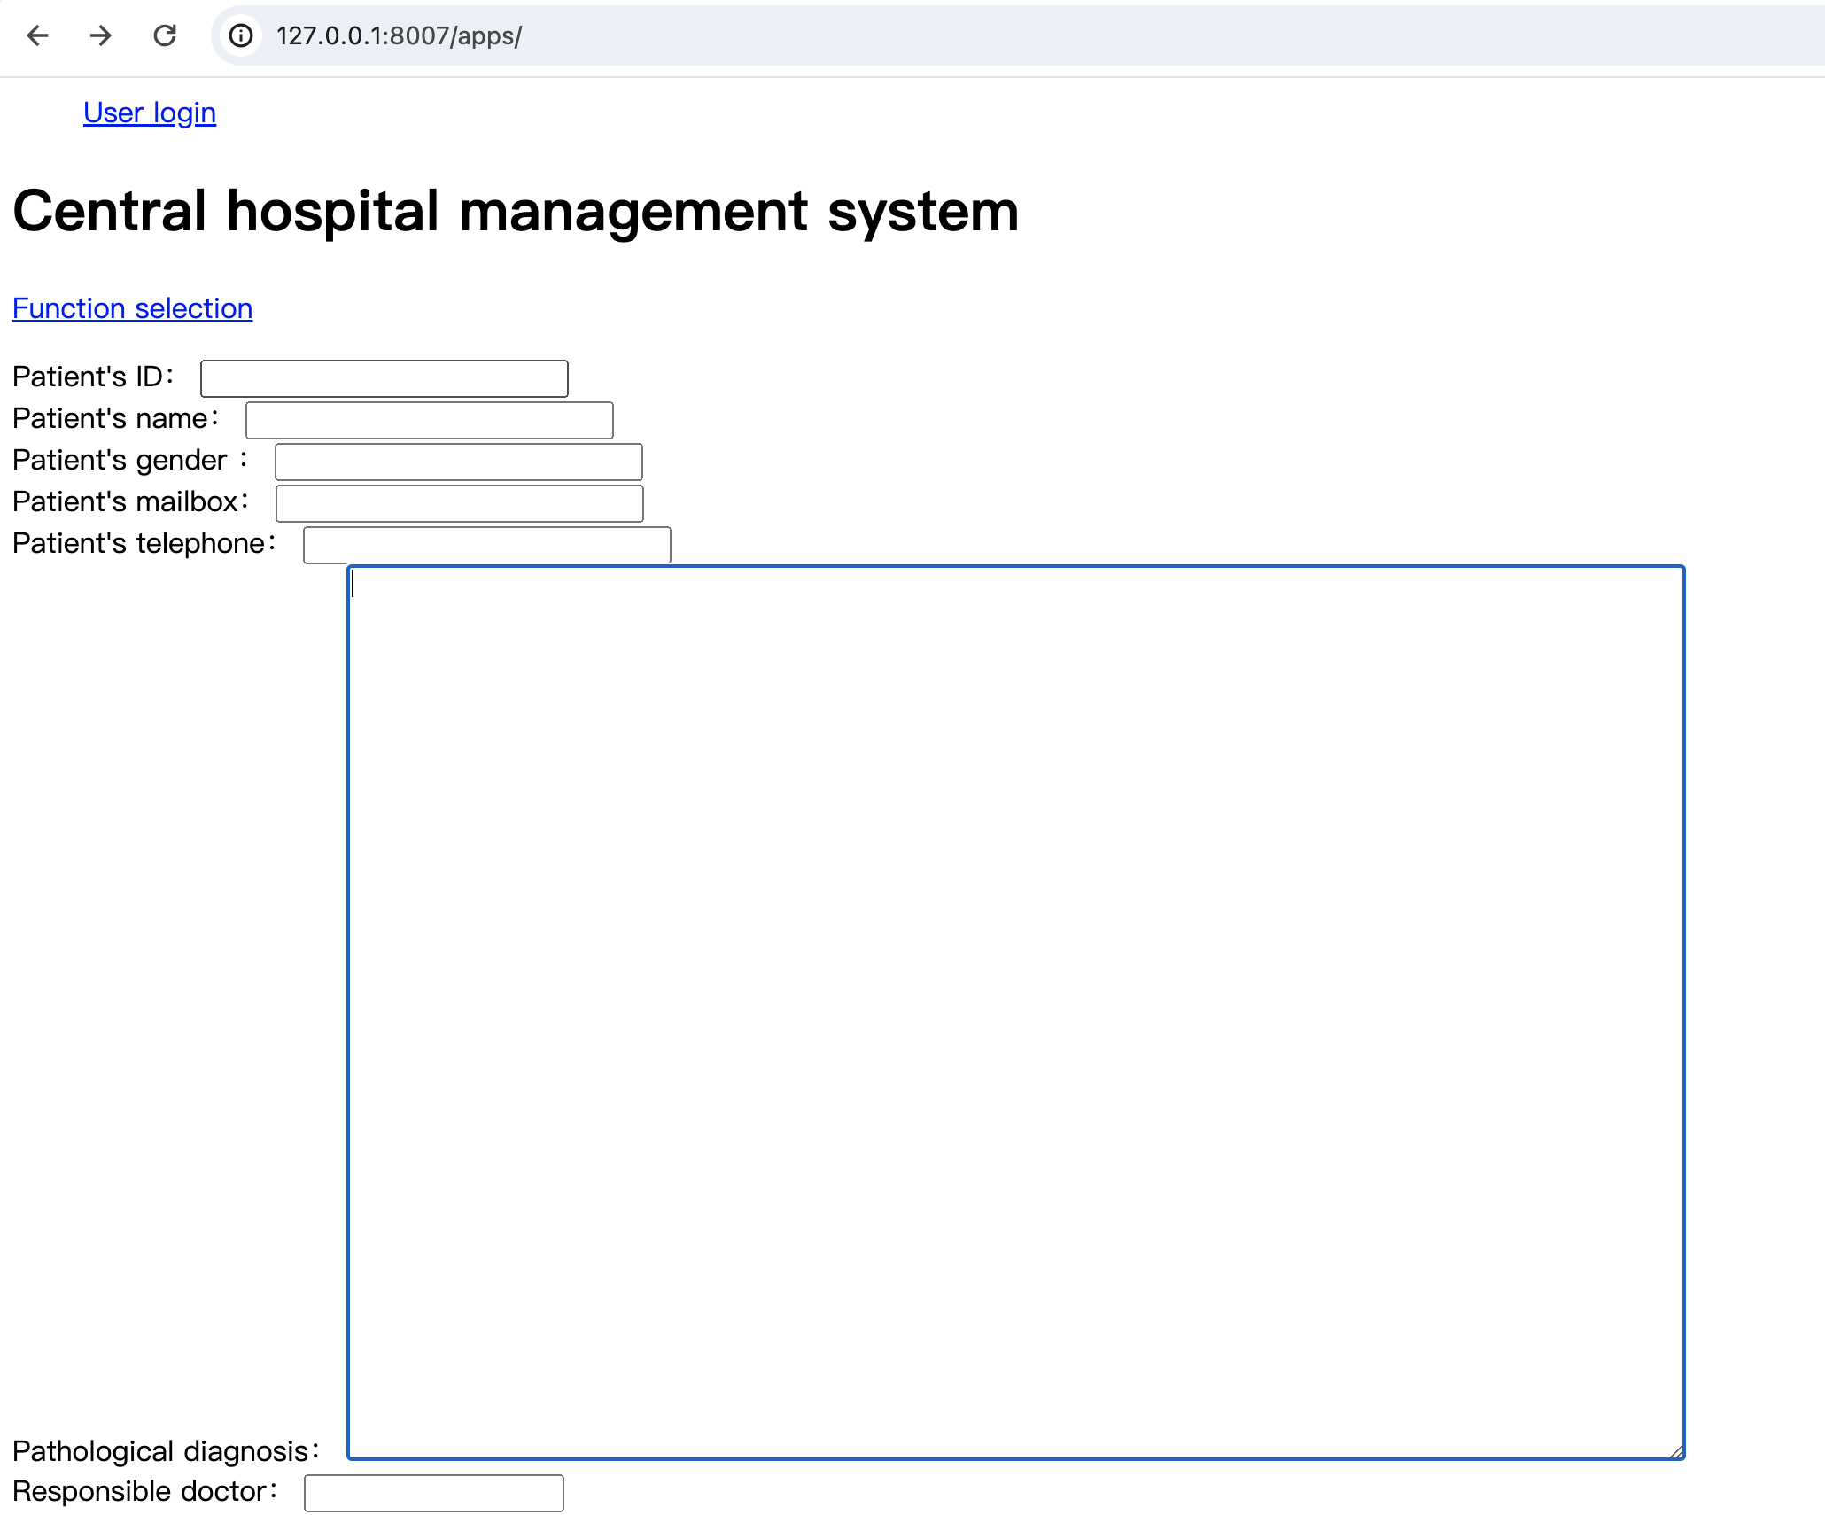
Patient item run result

Slide 5
Problems: Failed to get data through orm using json; Some html before and after association

